Slide 1

Anomaly Detection Practical – Challenge IV
Hamza Tahir & Muhammad Hamza Usmani
Technische Universität München
Fakultät für Informatik
13th December, 2016

Slide 2
The Task
Machine Learning Task
The machine learning task for this challenge is to determine if a PEInfo is a benign datapoint or an malignant.
The Dataset
The dataset consists of PEinfo files.
There are 9,753 records training samples.
4,753 benign samples
5,000 malicious samples
46,784 test samples.

Slide 3
Looking Into The Data
{
"peinfo":{
"imphash":"4a128e034b29626b284abefbf44f9089",
"exports":[]
"imports":[
{
"function":"tolower",
"dll":"msvcrt.dll"
},],
"rich_header":{
" "version_info":[],
"debug":[],
"timestamp":{
"human_timestamp":"2013-04-25T20:23:21Z",
"timestamp":1366921401
}
},
}
Given Data Was Raw.
Did not look nice
Difficult to comprehend
Used JSON formatting to better look at data, get features.
Randomly chose 5 malignant & benign samples.
Identified potential features.
Also considered comparing hashes.
But: accuracy depends upon attacker model & attacker definition & capabilities.

Slide 4
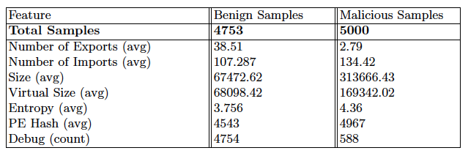
FEATURE EXTRACTION
Feature 1: Size of Sample
Length (count of characters) in the json encoding of each dataset.
Reasoning: In our manual analysis, we noted that malicious files sometimes had lesser length than benign files.

Slide 5
FEATURE EXTRACTION
Feature 2, 3: Number of Exports & Imports
This feature represents count of the number of functions exported & imported in a PEinfo sample.
Reasoning: In our manual analysis, we noted that malicious files had a lot less exports & imports (usually even 0 exports).

Slide 6
FEATURE EXTRACTION
Feature 4: DLLs
Bag of words representation of DLL presence & absence.
Reasoning: We found some DLLs like COMCTL32.dll only in benign files.
Over 1000 columns in bag of words like representation

Slide 7
FEATURE EXTRACTION
Feature 5: PE Sections
This feature represents average of:
Size, Virtual Size & Entropy in case of presence, else -1
Reasoning: In our manual analysis, we noted that malicious files had higher averages.

Slide 8
FEATURE EXTRACTION
Feature 6: PE Hash
This feature represents presence or absence of PE Hash in a sample.
Reasoning: In our manual analysis, we noted that malicious files had missing PE sections.

Slide 9
FEATURE EXTRACTION
Feature 7: Rich Header
We took an average/max of the "Times Used" value, if present.
Reasoning: In our manual analysis, we noted that some malicious files had this section missing and most benign files had it present.

Slide 10

The Usual Stuff
Processing
Feature Scaling
Resampling
Random resampling
Classification Techniques
1 Random Forest (Supervised, meta heuristic) | 2 Extra Trees Classifier (Supervised)
3 Multilayer Perceptron (Supervised, with logistic, tanh, relu kernels) | 4 KNN (Supervised, with K tuned between 2 and 100)
5 Support Vector Machines (Supervised, with linear, poly and sigmoid kernels) | 6 DBScan (Unsupervised, with little tuning)
7 Adaboost (Supervised, meta heuristic technique)

Slide 11
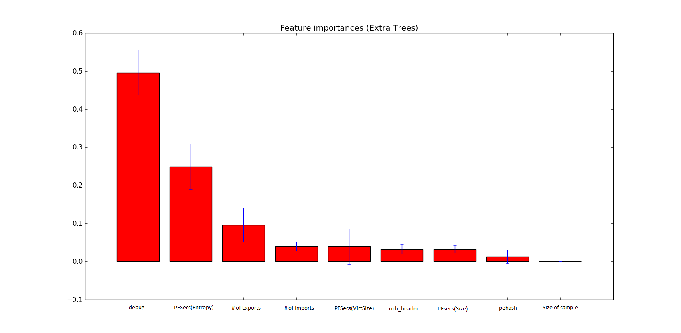
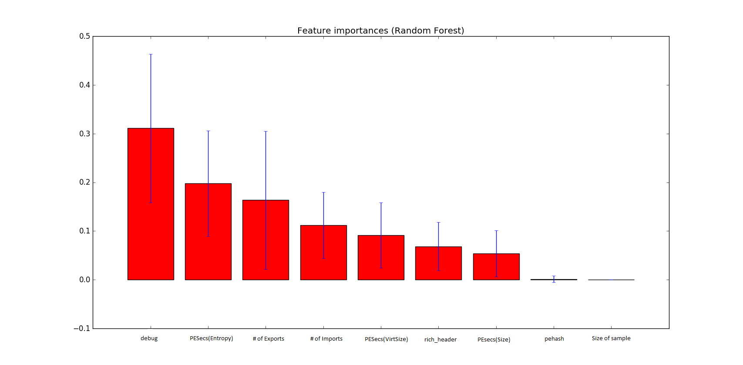
Feature Importance
Thus Discarded, PEHash & Size of Sample features.

Slide 12
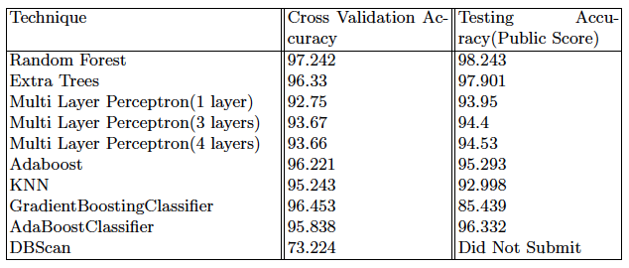
Results: Accuracies

Slide 13
Thank you!

